Slide 1
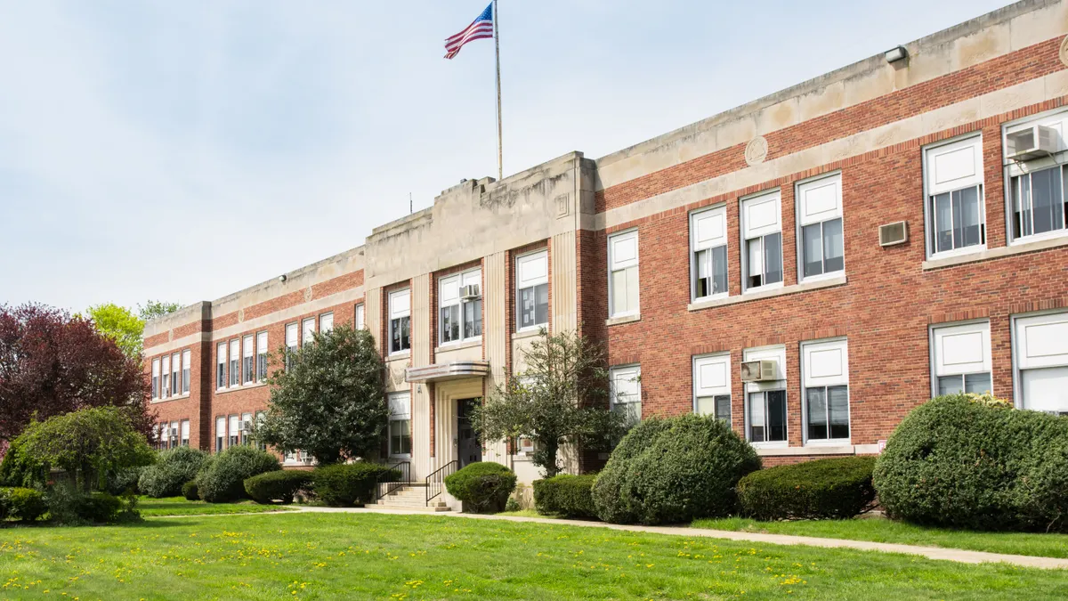



School Buddy
SCHOOL DATA REPORT
2019-2021
Aradhya Srivastava

Slide 2

Introduction
School Buddy is a new startup that helps students in identifying best schools as per their stream preferences. There are three streams in which students seek admission after passing their 10th board exams. Subjects for each of these streams are as follows:
Arts - Hindi, English, History, Geography and Civics
Science - Mathematics, Physics, Chemistry, Biology and Computer Science
Commerce - Hindi, English, Mathematics, Computer Science and Physical Education
School Buddy has collected marks scored by the same students for all the subjects for 3 consecutive years.

Slide 3
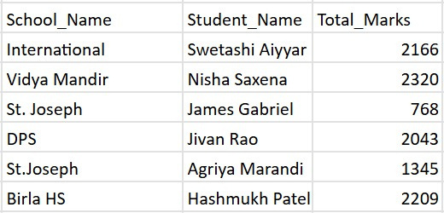

The top performer (student) of each school based on cumulative marks scored in last three years for all the subjects

Slide 4
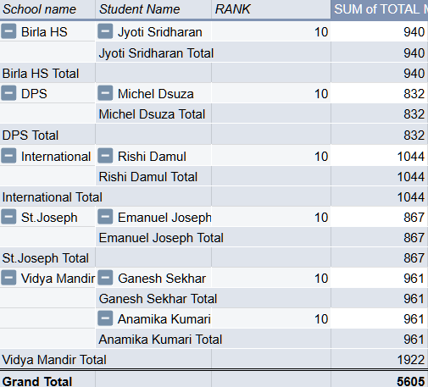
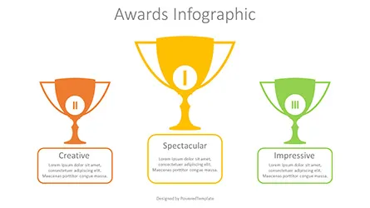
Rank each student within their own school based on their total marks scored in the year 2020 and compare the marks of Rank 10 for each school by arranging them in descending order

Slide 5
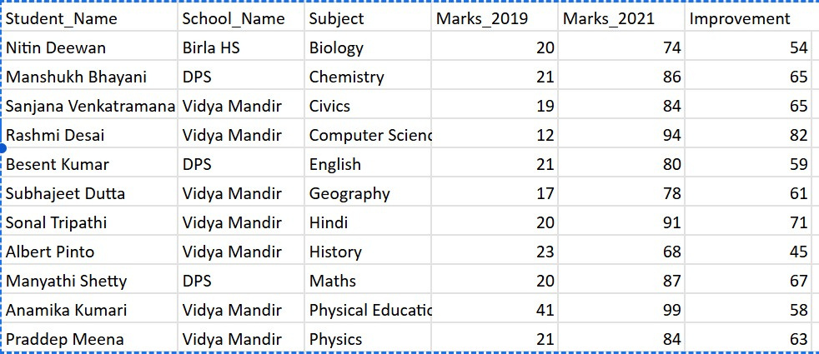
Find out students with the highest improvement for each subject from 2019-21 combining all the schools together
For Bigquery code- Link

Slide 6
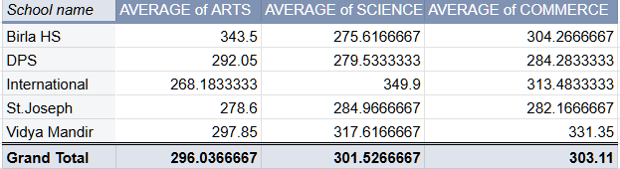
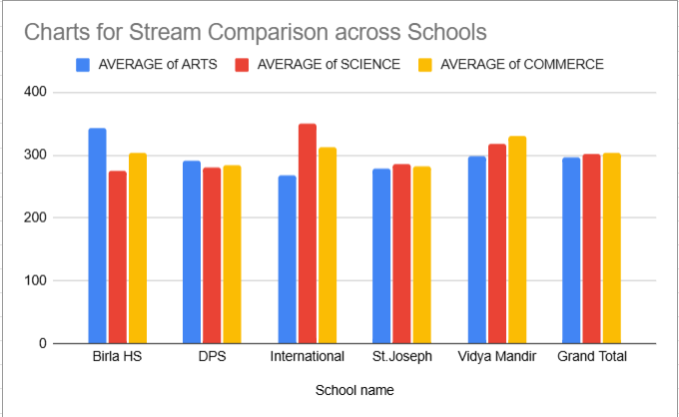
Identify best school for Arts, Science and Commerce streams based on marks scored by students in respective subjects for those streams in last three years
BEST SCHOOL FOR ARTS- BIRLA HS
BEST SCHOOL FOR SCIENCE- INTERNATIONAL
BEST SCHOOL FOR COMMERCE-ST.JOSEPH
Graph daal skte apan ek histogram type

Slide 7
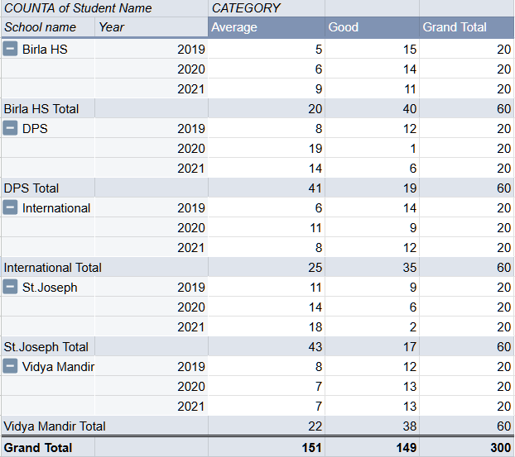
Counts of Students
If the marks obtained for each
subject can be categorised
under 5 sections like below:
<=20 - Very Poor
20 - <=40 - Poor
40 - <=60 - Average
60 - <=80 - Good
80 - <=100 - Very Good
Graph daal skte apan ek histogram type

Slide 8
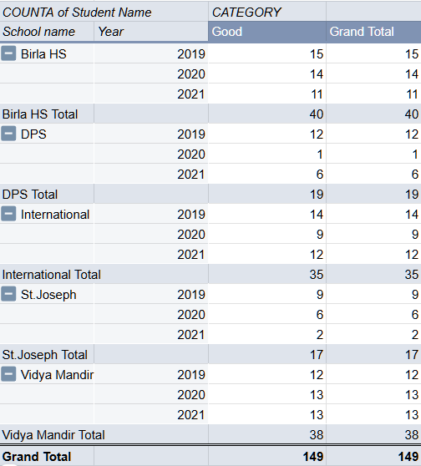
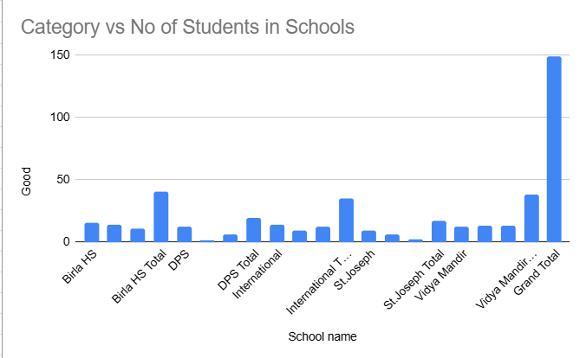
Which is the best school for each year 2019, 2020 and 2021 based on highest no. of students in Good and Very Good category
From the table we can see Birla HS school has the highest number of students in good category(i.e. 40)
Graph daal skte apan ek histogram type

Slide 9
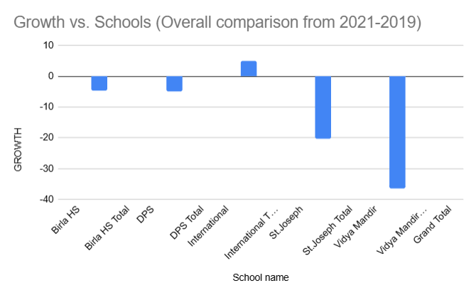
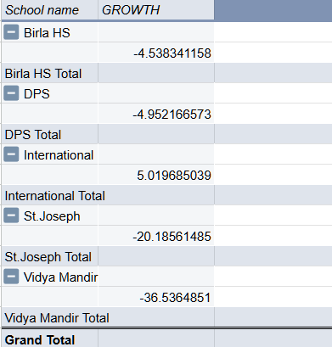
Which is the fastest-growing School in Bangalore (Overall and Streamwise)?
Overall
Only International school is the fastest growing in Bengaluru
Graph daal skte apan ek histogram type

Slide 10
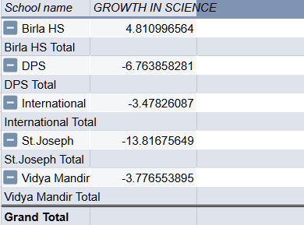
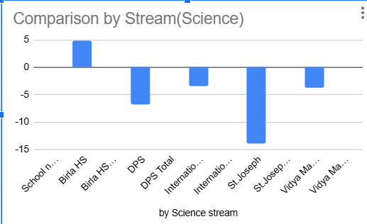
Which is the fastest-growing School in Bangalore (Overall and Streamwise)?
Science
For Science stream Birla HS is best
Graph daal skte apan ek histogram type

Slide 11
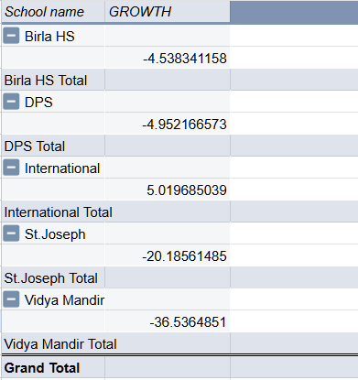
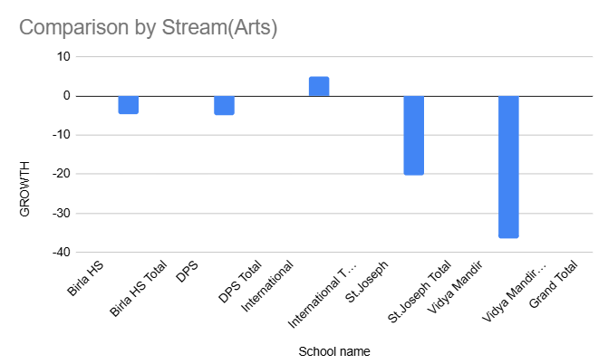
Which is the fastest-growing School in Bangalore (Overall and Streamwise)?
Arts
for Arts stream International school is best
Graph daal skte apan ek histogram type

Slide 12
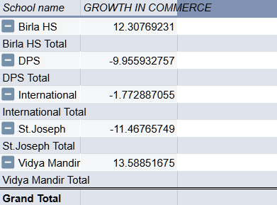
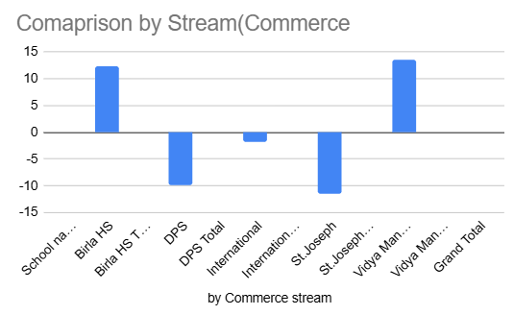
Which is the fastest-growing School in Bangalore (Overall and Streamwise)?
Commerce
-for commerce Vidya Mandir is the best
Graph daal skte apan ek histogram type

Slide 13

School Buddy
Thank You
For your attention

